Slide 1
WEB REQUEST LIFE CYCLE
GOWTHAM R

Slide 2
Activity
Step 1: Your PC or device is connected to the web through a modem or router. Together, these devices allow you to connect to other networks around the globe . Your router enables multiple computers to join the same network while a modem connects to your ISP (Internet Service Provider) which provides you with either cable or DSL internet.
Step 2: Type in a web address, known as a URL (Uniform Resource Locator). Each website has its own unique URL that signals to your ISP where you want to go.
Step 3: Your query is pushed to your ISP which connects to several servers which store and send data like a NAP Server (Network Access Protection) and a DNS (Domain Name Server). Next, your browser looks up the IP address for the domain name you typed into your search engine through DNS. DNS then translates the text-based domain name you type into the browser into the number-based IP address. Example: Google.com becomes 64.233.191.255

Slide 3
Step 4: Your browser sends a Hypertext Transfer Protocol (HTTP) request to the target server to send a copy of the website to the client using TCP/IP.
Step 5: The server then approves request and sends a “200 OK” message to your computer. Then, the server sends website files to the browser in the form of data packets.
Step 6: As your browser reassembles the data packets, the website loads allowing you to learn, shop, browse, and engage.
Step 7: Enjoy your search results!

Slide 4
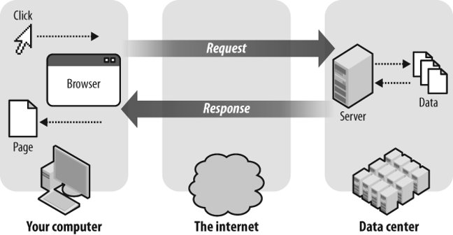

Slide 5


